Slide 1

“Factors to Consider When Deciding to Move into Senior Living”
Presented By: Anne Alms, Director of Sales and Outreach
1140 KENNEDY PARKWAY | CORALVILLE, IA | 52241 | STIRLINGSHIREOFCORALVILLE.COM

Slide 2


What kind of “senior living” or “senior care” do I or my loved one need?
There are many different options in senior living and senior care so determining what best fits your needs would be your very first step.
Home Care
Adult Day Programs
Stay by the Day
Journey Program
Independent Living
Cooperative Living
Assisted Living
Memory Care
1140 KENNEDY PARKWAY | CORALVILLE, IA | 52241 | STIRLINGSHIREOFCORALVILLE.COM
This Photo by Unknown Author is licensed under CC BY-SA

Slide 3

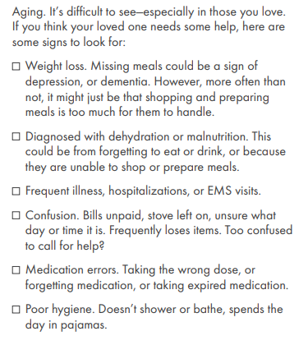
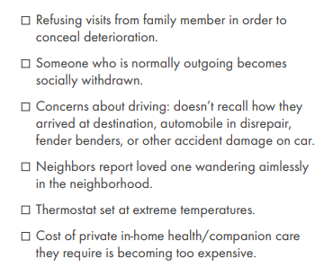
How do you know when your loved one needs help?
1140 KENNEDY PARKWAY | CORALVILLE, IA | 52241 | STIRLINGSHIREOFCORALVILLE.COM

Slide 4

Next, it’s Time to Have the Talk
Do some homework beforehand
Explore your options
Use a teachable moment as your springboard
Realize you may need to have the talk more than once
Don't wait for a crisis to take a tour
1140 KENNEDY PARKWAY | CORALVILLE, IA | 52241 | STIRLINGSHIREOFCORALVILLE.COM

Slide 5

Preparing Yourself for Community Visits
Find out what you want in a senior community for your loved one and what is most important for them in a community they call home – this will lay the groundwork
Find at least 3 communities to visit and ask for a guided tour – checklists could come in handy when comparing them
Understand the differences in the lifestyle offerings, the programming and the care at the communities
Ask for help if and when you need it from the Sales Director; they can often provide valuable tools and resources you may not think to ask for
1140 KENNEDY PARKWAY | CORALVILLE, IA | 52241 | STIRLINGSHIREOFCORALVILLE.COM

Slide 6
Questions to Ask on Your Tour
What is the monthly rent, and what is included? Is a deposit necessary?
Can you break down the charges for care?
Are there additional fees?
What happens if a resident runs out of money?
Do you accept long-term care insurance?
Is staff available 24/7?
Do we need to bring our own furniture?
What kind of spiritual health offerings do you have?
What type of activities are included? If possible, arrange to visit when an activity is happening, so you can get a picture of daily life there. Are the residents participating? Is the staff happy and engaged?
How is memory care approached? For example, at Ebenezer, we offer our Dimensions Program, which is designed to make a dramatic difference in memory care, using evidence-based best practices.
Who are the care team? Sometimes, it's possible to meet with care workers to get an overall picture of life at the residence.
1140 KENNEDY PARKWAY | CORALVILLE, IA | 52241 | STIRLINGSHIREOFCORALVILLE.COM

Slide 7

Getting Things in Order for The Move
Doctor Visit
Make an appointment with Mom or Dad's primary doctor
Personal Paperwork
Talk about and sign personal paperwork
Discuss House
Talk about what to do with the house
Change Address
Fill out a change of address form
Floor Plan Layout
Get the dimensions and floorplan of their new unit
Move Manager
Consider using a senior moving specialist
Attend Events
Attend some events at the new community
1140 KENNEDY PARKWAY | CORALVILLE, IA | 52241 | STIRLINGSHIREOFCORALVILLE.COM

Slide 8

Get Settled and Enjoy Community Amenities
Once your loved one is moved in, make sure the community you’ve chosen has a plan on how they will assist them get acclimated to join in on community events.
Then, enjoy PEACE OF MIND for yourself and QUALITY OF LIFE with QUALITY CARE for your loved one!
1140 KENNEDY PARKWAY | CORALVILLE, IA | 52241 | STIRLINGSHIREOFCORALVILLE.COM

Slide 9

Questions?
Contact Information:
Anne Alms
Anne.Alms@Fairview.org
(319) 249-6316
1140 KENNEDY PARKWAY | CORALVILLE, IA | 52241 | STIRLINGSHIREOFCORALVILLE.COM

